Slide 1
Online Bidding Marketplace
Resell Your Trendy Products
IMT 543 | Group 2
Qiupan Jin, Serena Lin, Karvie Xia, Wenyue Yin (Regina)

Slide 2
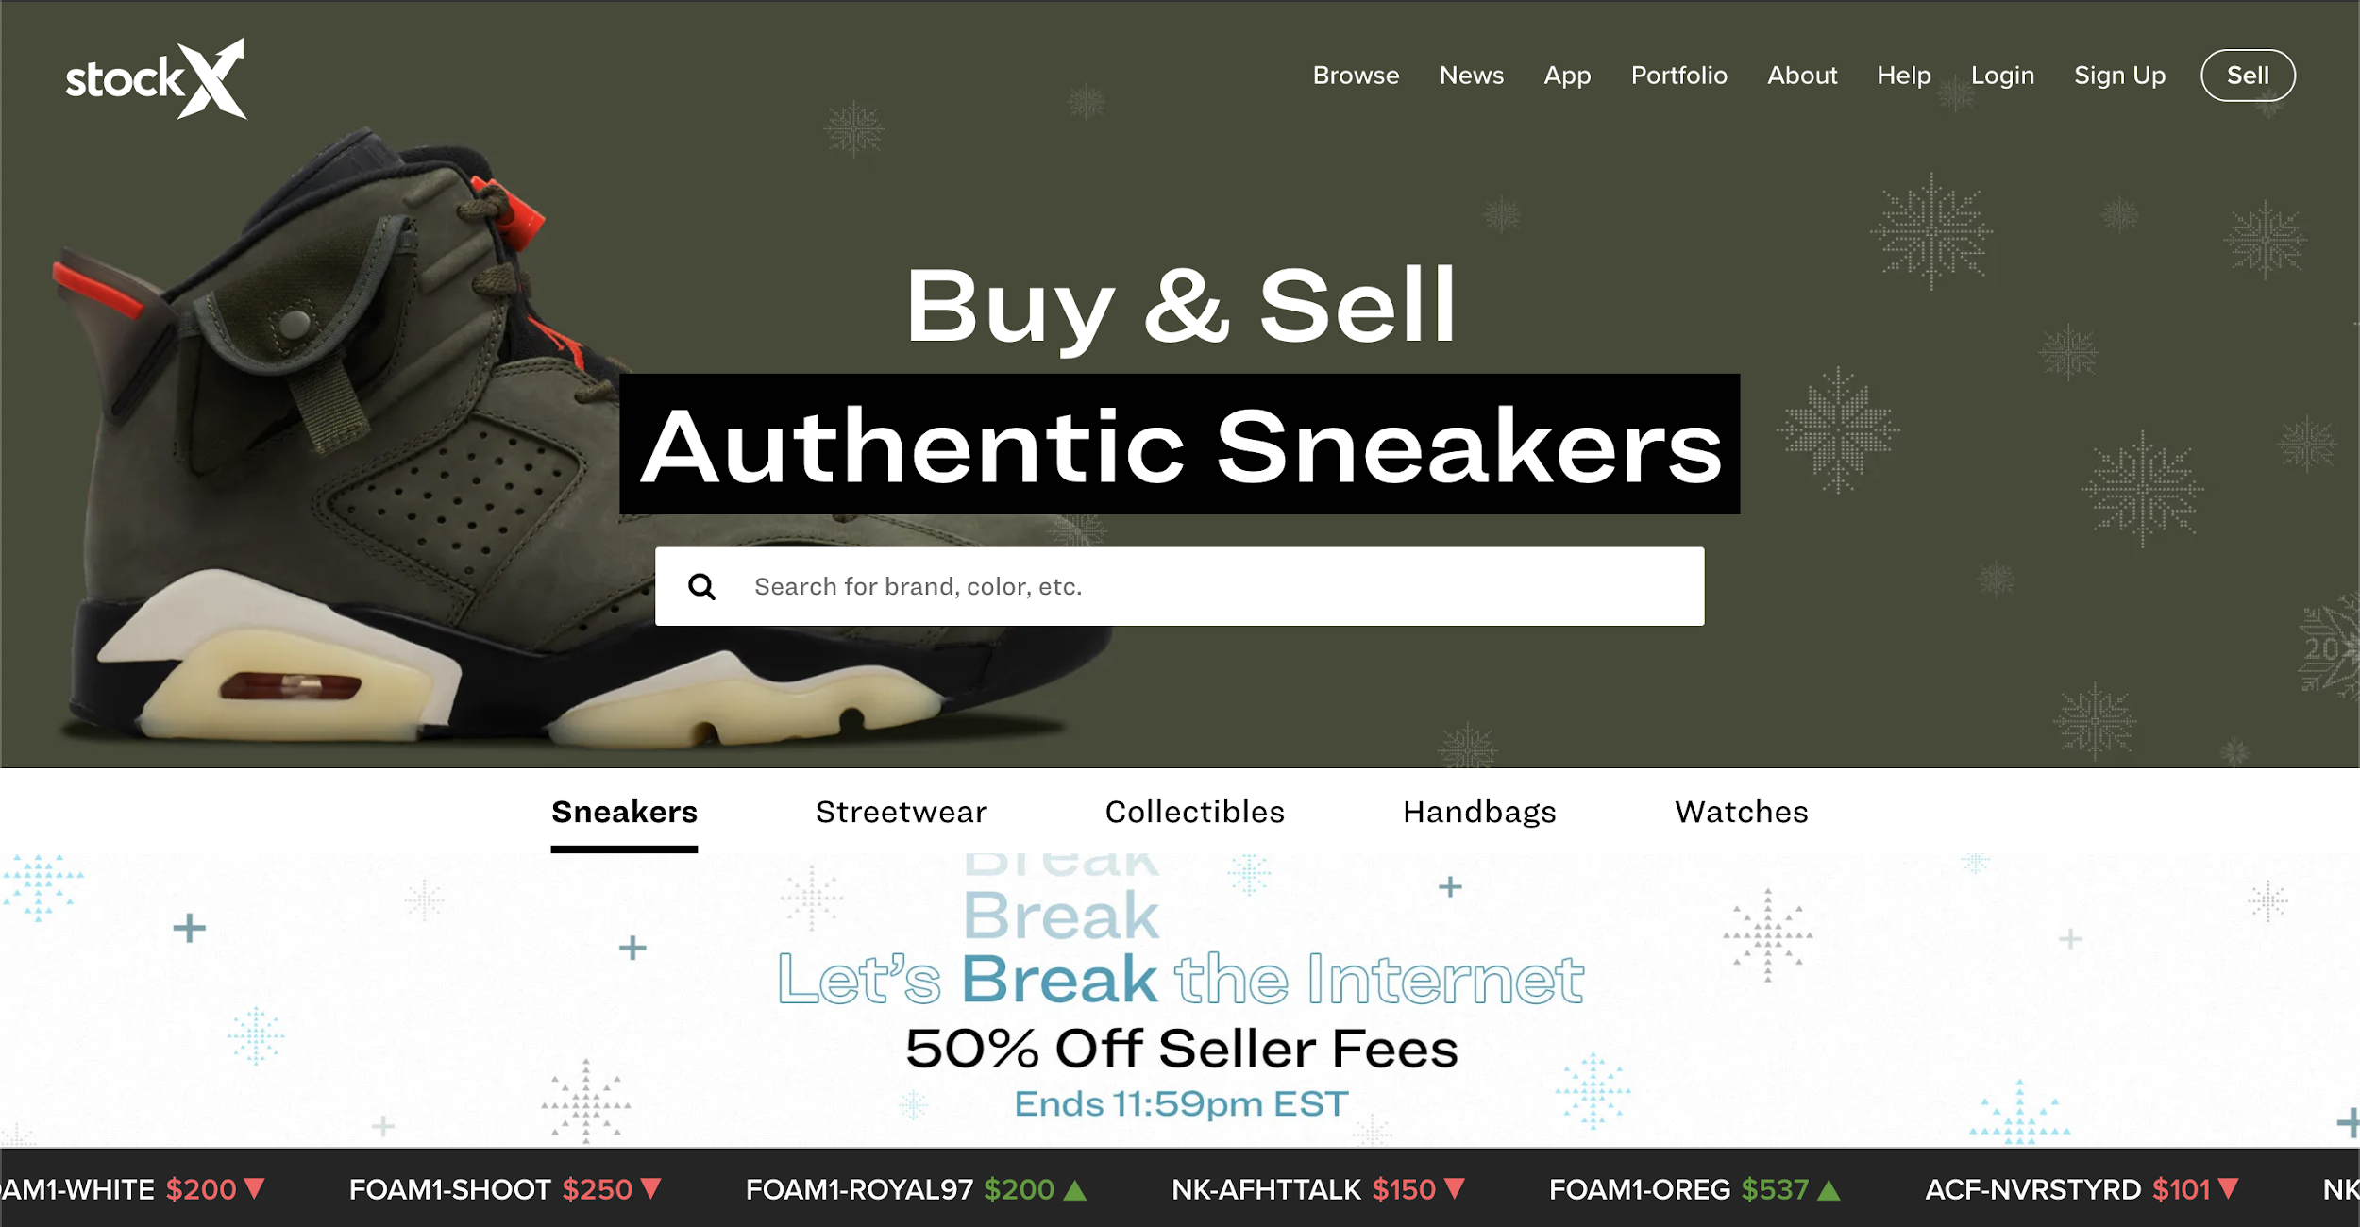
Project Background

Slide 3
Business Problems
The database is designed to support the successful operation of the website, and it can only be used by approved employees.
The core business of the website is a bidding system that enables transactions between sellers and buyers, so the company would pay special attention to the transaction integrity and users’ behaviors. Business problems being addressed by the database include:
To record and maintain the key information of users, products, orders, etc.
To track and report the users’ activities and the current trend of the products.
To provide information to improve brand behavior.

Slide 4

Business Rules
Each user can buy or sell multiple products on the platform.
Each user can add multiple products into his/her wishlist.
The same product type, for example, a jacket with the code UW12345, can be sold by multiple sellers.
Each product type posted by a single seller will create a new record in the Product entity.
Each product can be bidden by multiple buyers.
Notes:
These are the basic business rules we set in this database. Each user can buy or sell multiple products on the platform. Also, they can add multiple products in his/her wishlist. The same product type, for example, a jacket with the code UW12345, can be sold by multiple sellers. Each product type posted by a single seller will create a new record in the Product entity. And each product can be bidden by multiple buyers.

Slide 5

Database Objectives
Transaction integrity
All users’ information and product verification should be recorded.
Bidding system
Sellers can upload information and prices for items they want to sell, and buyers can comment and bid on those products.
User experience
Users should have a seamless experience in viewing price fluctuations, product wishlist, news notifications and so on.
Categories expansion
Current product types could include shoes, clothes, bags, watches and so on, yet the database should support future expansion of these categories.
Maintain
Search
Track
Report
Notes:
The objective of our database is to support the daily operation of the website. It must ensure transaction integrity, record all users’ information and product verification. And support our bidding system in which sellers can upload information and prices for items they want to sell, and buyers can comment and bid on those products. It should improve user experience and allow future expansion of the product categories.

Slide 6
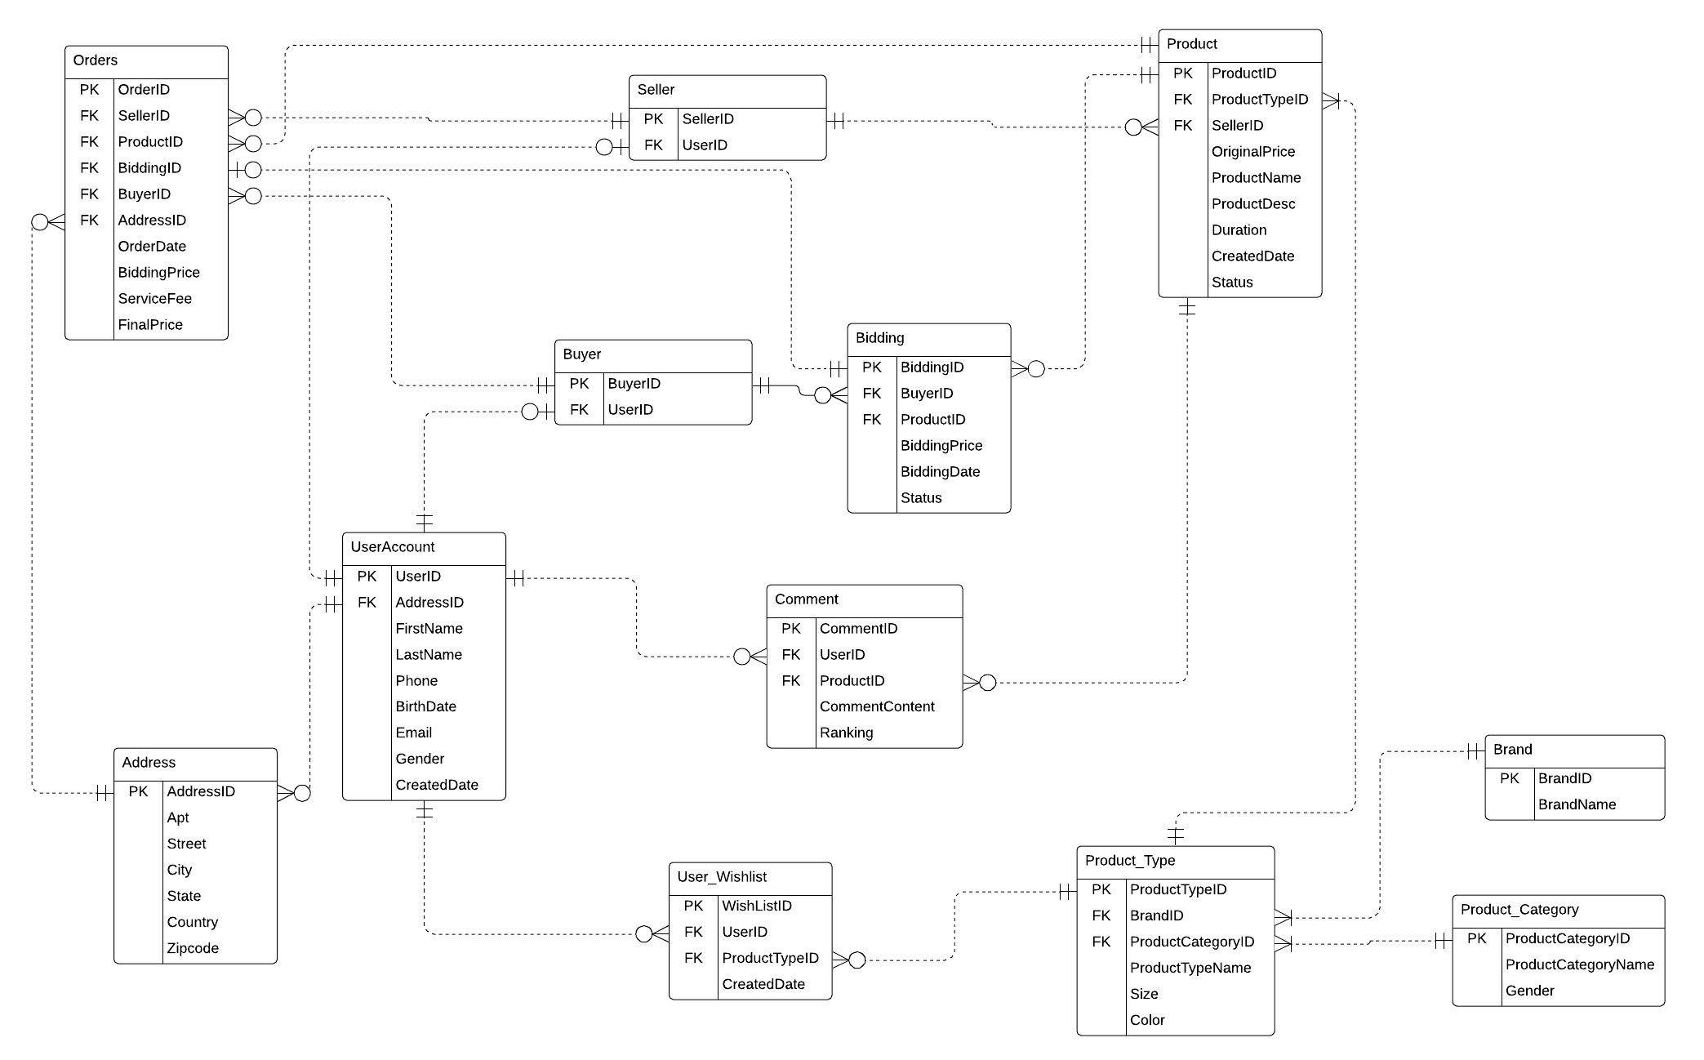
Final ERD
12 Entities
UserAccount
Buyer
Seller
Address
Product
Product_Type
Brand
Product_Category
Bidding
Orders
User_Wishlist
Comment

Slide 7

SQL DDL Statements
DROP
IF EXISTS (SELECT * FROM sysobjects WHERE name = 'FK_Product_Category_ProductCategoryID')
BEGIN
ALTER TABLE Product_Type DROP CONSTRAINT FK_Product_Category_ProductCategoryID
END
IF EXISTS (SELECT TABLE_NAME FROM INFORMATION_SCHEMA.TABLES WHERE TABLE_SCHEMA = 'dbo' AND TABLE_NAME = 'Product_Category')
BEGIN
DROP TABLE Product_Category
END

Slide 8
SQL DDL Statements
CREATE TABLE
CREATE TABLE Bidding(
BiddingID int IDENTITY(1,1) NOT NULL
CONSTRAINT PK_Bidding_BiddingID PRIMARY KEY,
BuyerID int NOT NULL
CONSTRAINT FK_Buyer_BuyerID FOREIGN KEY REFERENCES Buyer(BuyerID),
ProductID int NOT NULL
CONSTRAINT FK_Bidding_ProductID FOREIGN KEY REFERENCES Product(ProductID),
BiddingPrice money NOT NULL,
BiddingDate datetime NOT NULL
CONSTRAINT DF_Bidding_BiddingDate DEFAULT(CURRENT_TIMESTAMP),
Status varchar(100) NOT NULL)

Slide 9
SQL DDL Statements
CREATE TABLE
CREATE TABLE Comment(
CommentID int IDENTITY(1,1) NOT NULL,
UserID int NOT NULL,
ProductID int NOT NULL,
CommentContent nvarchar(255),
Ranking decimal(2,1),
CONSTRAINT PK_CommentID PRIMARY KEY (CommentID),
CONSTRAINT FK_UserAccount_UserID FOREIGN KEY (UserID) REFERENCES UserAccount(UserID),
CONSTRAINT FK_Product_ProductID FOREIGN KEY (ProductID) REFERENCES Product(ProductID),
CONSTRAINT CHK_Comment_Ranking_Range CHECK (Ranking BETWEEN 0 AND 5)
)

Slide 10
SQL DDL Statements
CREATE VIEW
CREATE VIEW Bidding_Brand AS
SELECT Brand.BrandName, COUNT(Bidding.BiddingID) AS Biddingtimes
FROM Brand
LEFT JOIN Product_Type
ON Brand.BrandID = Product_Type.BrandID
LEFT JOIN Product
ON Product_Type.ProductTypeID = Product.ProductTypeID
LEFT JOIN BIDDING
ON Bidding.ProductID = Product.ProductID
GROUP BY Brand.BrandName;

Slide 11
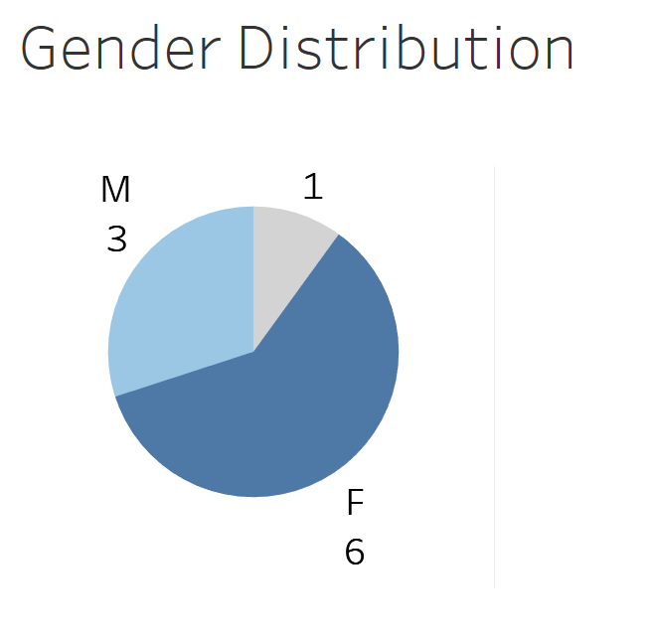
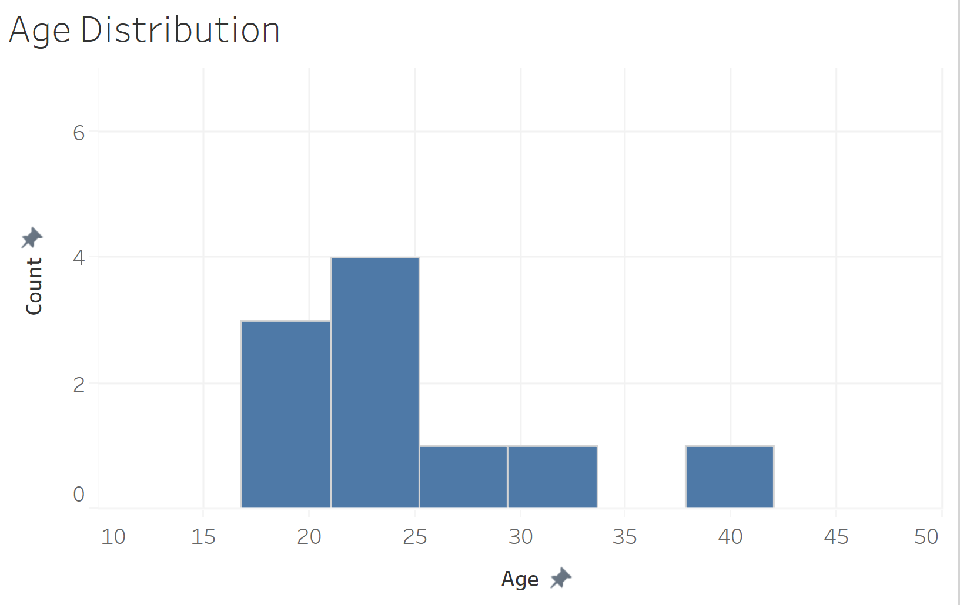
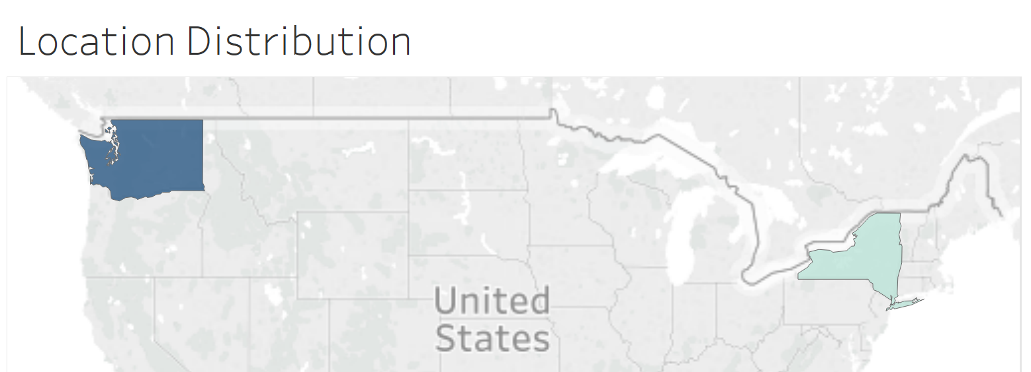
Customer Information
Target group:
Young Adults
Location:
Seattle base

Slide 12
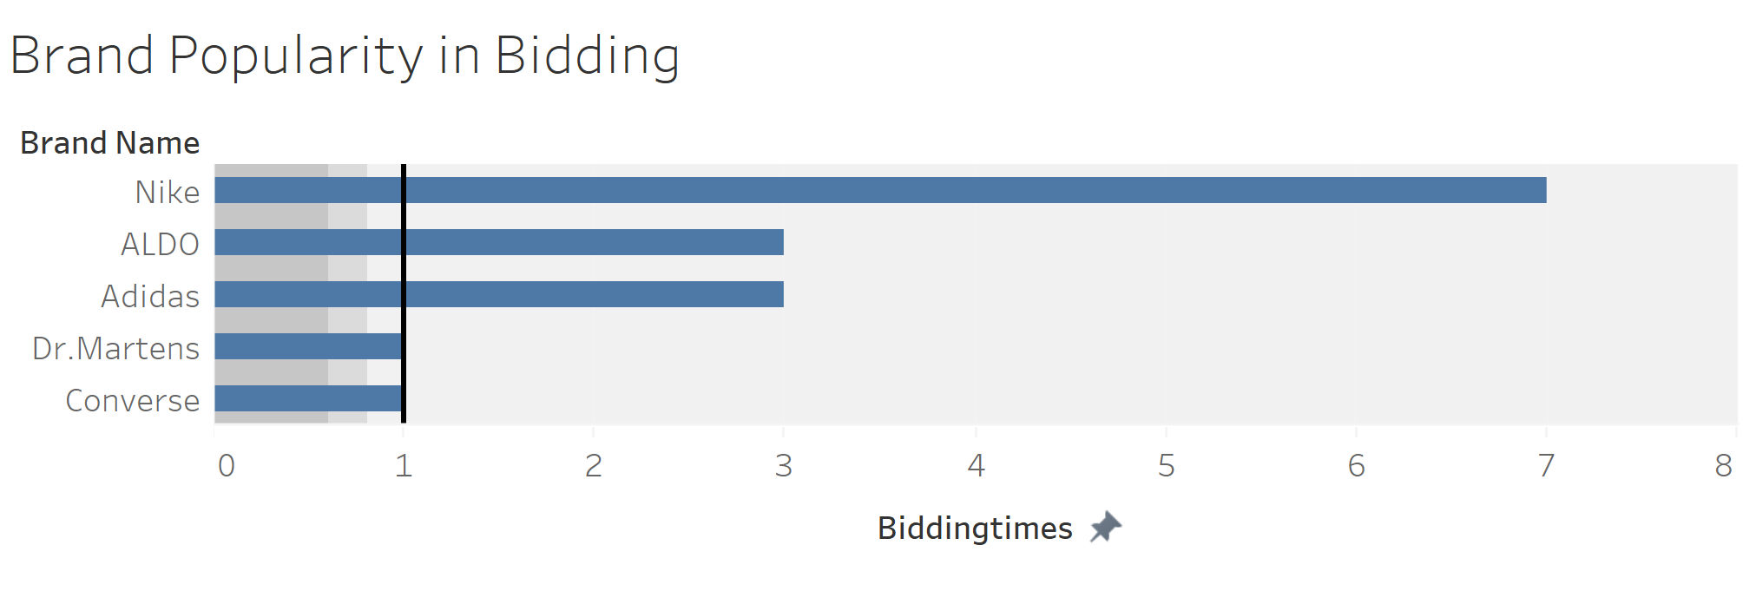
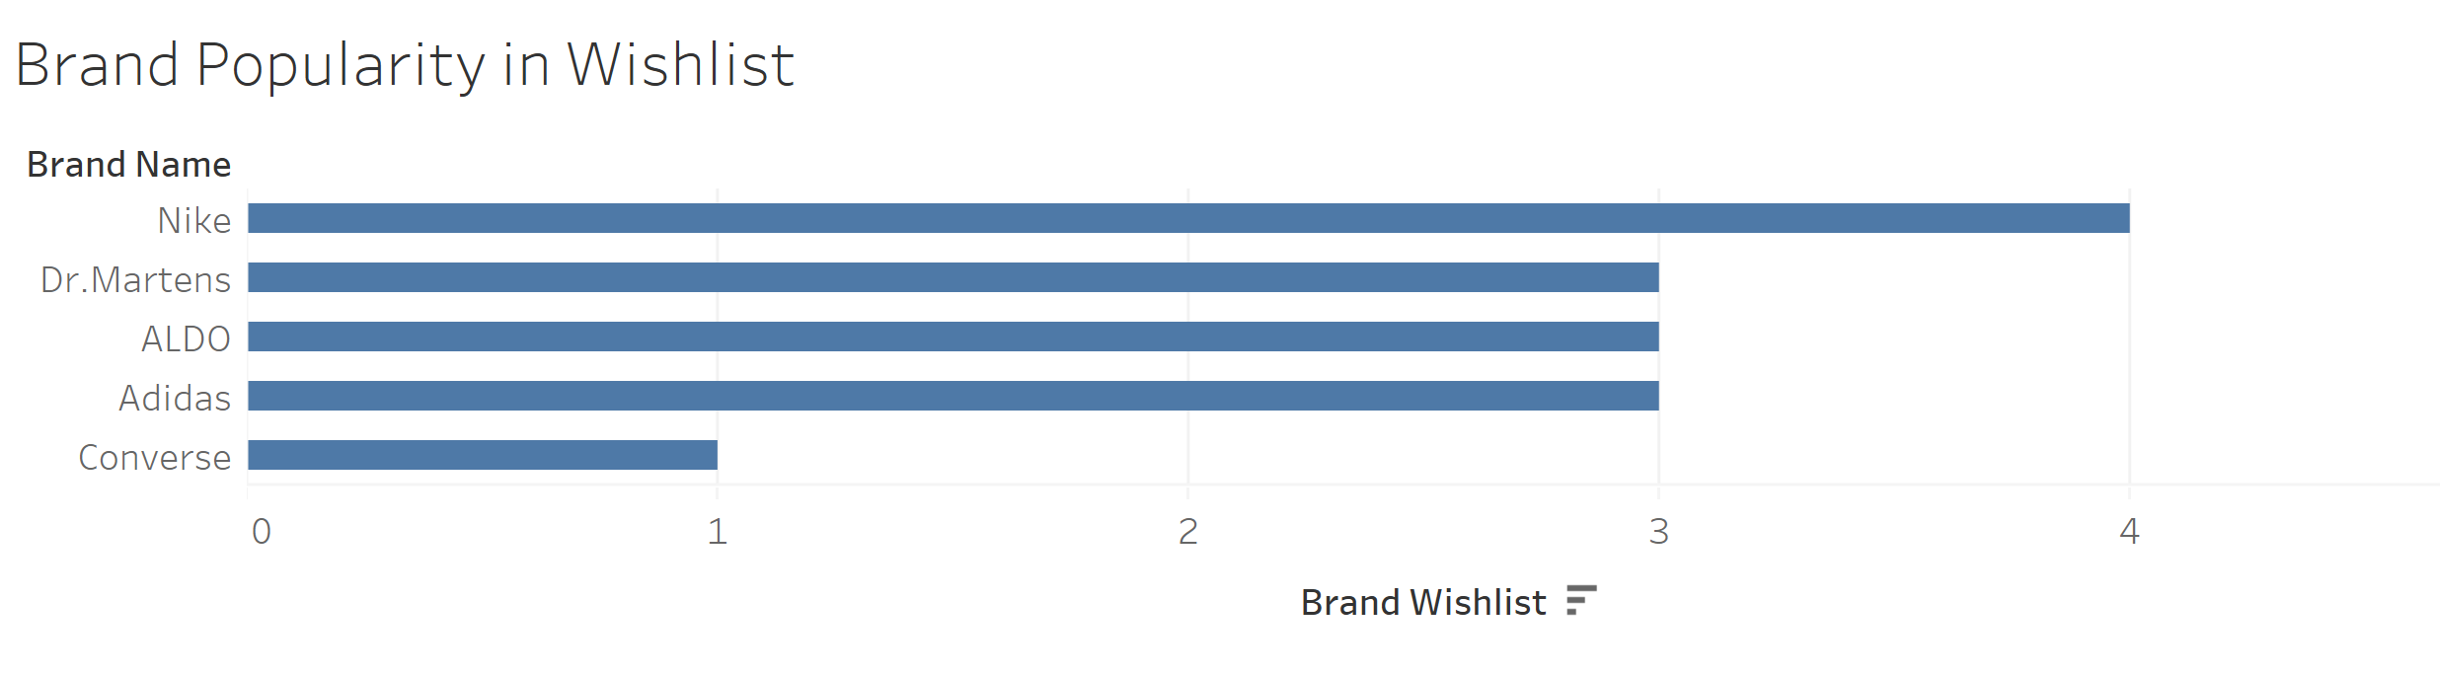

Brand Popularity by Bidding vs. Wishlist

Slide 13
Thank You

